Slide 1
function ALPHA-BETA-SEARCH(state) returns an action
inputs: state, current state in game
v←MAX-VALUE(state, - ∞ , +∞)
return an action in ACTIONS(state) with value v
function MAX-VALUE(state,α , β) returns a utility value
if TERMINAL-TEST(state) then return UTILITY(state)
v ← - ∞
for a in ACTIONS(state) do
v ← MAX(v,MIN-VALUE(Result(s,a), α , β))
if v ≥ β then return v
α ← MAX(α ,v)
return v
function MIN-VALUE(state, α , β) returns a utility value
if TERMINAL-TEST(state) then return UTILITY(state)
v ← + ∞
for a,s in SUCCESSORS(state) do
v ← MIN(v,MAX-VALUE(s, α , β))
if v ≤ α then return v
β ← MIN(β ,v)
return v

Slide 2
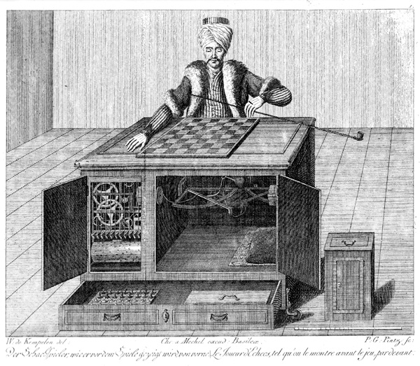
Game-playing AIs: Games and Adversarial Search
AIMA 5.1-5.5,
AIMA 16.1-16.3
Notes:
Puzzles Versus Games

Slide 3
Games: Outline of Unit
Part I: Games as Search
Motivation
Game-playing AI successes
Game Trees
Evaluation Functions
Part II: Adversarial Search
The Minimax Rule
Alpha-Beta Pruning

Slide 4
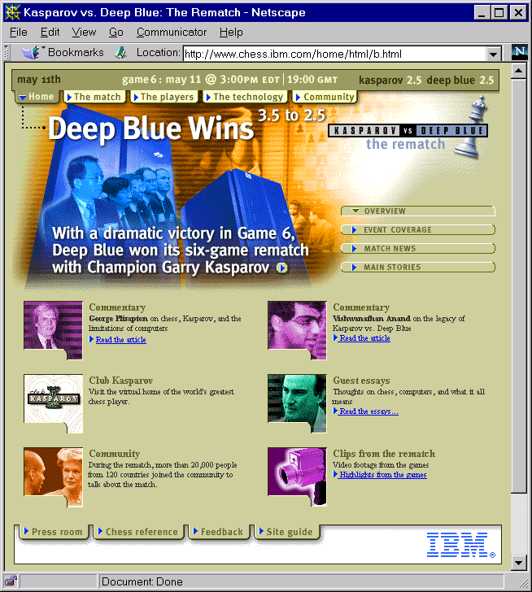
May 11, 1997

Slide 5
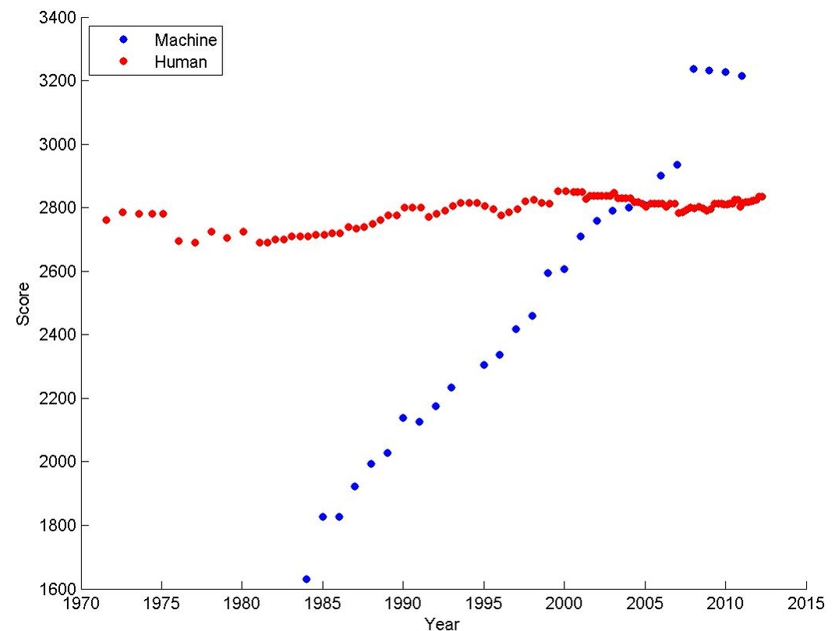
Ratings of human & computer chess champions
https://srconstantin.wordpress.com/2017/01/28/performance-trends-in-ai/
Notes:
Y axis shows Elo scores. The Elo^{[a]} rating system is a method for calculating the relative skill levels of players games like chess.

Slide 6
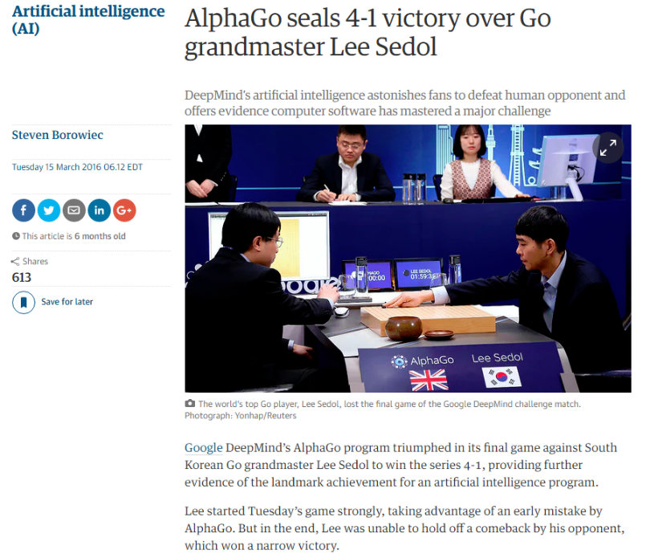
(from The Guardian)
Notes:
The board of Go is 19×19=361 intersections while Chess has 8×8=64 squares. The possible number of first moves in chess is 20 white × 20 black = 400 moves. In Go, it is 361×360=129960. Due to symmetry though, it is reduced to 32490, but it is still way more than chess. The opening of chess is fixed by custom and strong first moves are fixed at around 64 moves. The board of Go begins empty and the players put their stones anywhere that they wish to uniquely structure the board in every game. Strong starting first moves are fixed at 992.
The estimated number of possible board configuration is 10¹²º in chess which is astronomical but Go has around 10¹⁷⁴. It may not seem a lot more than chess's 10¹²º but it is actually 1 million trillion trillion trillion trillion more configurations than chess! That is a lot more.
The estimated number of atoms in the universe is about 10^80.
Chess is more like emphasising in short-term profits while Go is more like long-term planning. Chess is more like a single battle while Go is like a multi-front war.
https://www.quora.com/How-does-the-complexity-of-Go-compare-with-Chess

Slide 7
The Simplest Game Environment
Multiagent
Static: No change while an agent is deliberating
Discrete: A finite set of percepts and actions
Fully observable : An agent's sensors give it the complete state of the environment.
Strategic: The next state is determined by the current state and the action executed by the agent and the actions of one other agent.

Slide 8
Key properties of our sample games
Two players alternate moves
Zero-sum: one player’s loss is another’s gain
Clear set of legal moves
Well-defined outcomes (e.g. win, lose, draw)
Examples:
Chess, Checkers, Go,
Mancala, Tic-Tac-Toe, Othello …

Slide 9
More complicated games
Most card games (e.g. Hearts, Bridge, etc.) and Scrabble
Stochastic, not deterministic
Not fully observable: lacking in perfect information
Real-time strategy games, e.g. Warcraft
Continuous rather than discrete
No pause between actions, don’t take turns
Cooperative games

Slide 10
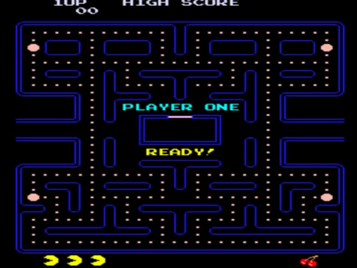
Pac-Man
https://youtu.be/-CbyAk3Sn9I
Notes:
https://www.youtube.com/watch?v=-CbyAk3Sn9I

Slide 11
Formalizing the Game setup
Two players: MAX and MIN; MAX moves first.
MAX and MIN take turns until the game is over.
Winner gets award, loser gets penalty.
Games as search:
Initial state: e.g. board configuration of chess
Successor function: list of (move,state) pairs specifying legal moves.
Terminal test: Is the game finished?
Utility function: Gives numerical value of terminal states. e.g. win (+∞), lose (-∞) and draw (0)
MAX uses search tree to determine next move.

Slide 12
How to Play a Game by Searching
General Scheme
Consider all legal successors to the current state (‘board position’)
Evaluate each successor board position
Pick the move which leads to the best board position.
After your opponent moves, repeat.
Design issues
Representing the ‘board’
Representing legal next boards
Evaluating positions
Looking ahead

Slide 13
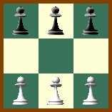
Hexapawn: A very simple Game
Hexapawn is played on a 3x3 chessboard
Only standard pawn moves:
A pawn moves forward one square onto an empty square
A pawn “captures” an opponent pawn by moving diagonally forward one square, if that square contains an opposing pawn. The opposing pawn is removed from the board.

Slide 14
Hexapawn: A very simple Game
Hexapawn is played on a 3x3 chessboard
Player P₁ wins the game against P₂ when:
One of P₁’s pawns reaches the far side of the board, or
P₂ cannot move because no legal move is possible.
P₂ has no pawns left.
(Invented by Martin Gardner in 1962, with learning “program” using match boxes. Reprinted in “The Unexpected Hanging..)

Slide 15
Hexapawn: Three Possible First Moves
 |  | 
 |  | 
White moves
 |  | 

 |  | 
 |  | 
 | 
 |  | 
 |  | 
 |  | 
 | 

Slide 16
Game Trees
Represent the game problem space by a tree:
Nodes represent ‘board positions’; edges represent legal moves.
Root node is the first position in which a decision must be made.

Slide 17
Hexapawn: Simplified Game Tree for 2 Moves
 |  | 
 |  | 
White to move
 |  | 

 |  | 
 |  | 
 | 
 |  | 
 |  | 
 |  | 
 | 
Black to move
…..
 |  | 

 |  | 
 |  | 
 | 
 |  | 
 | 
 |  | 
 |  | 
 |  | 
 | 
 |  | 
 |  | 
 | 
 |  | 
 | 
 |  | 
 |  | 
 | 
 | 
 |  | 
White to move

Slide 18

Adversarial Search
Image from Dan Klein
Notes:
Image from Dan Klein

Slide 19
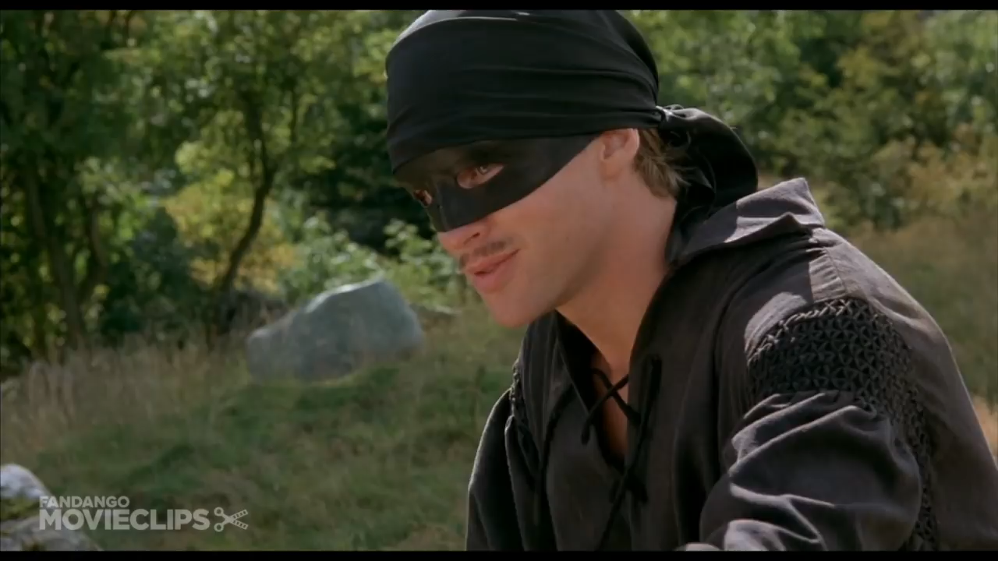
Battle of Wits
https://www.youtube.com/watch?v=rMz7JBRbmNo
Notes:
Turn volume up!
Good stopping points:
1:27 – “Truly you have a dizzying intellect”
3:15 – “Death of the sicilian”

Slide 20
MAX & MIN Nodes : An egocentric view
Two players: MAX, MAX’s opponent MIN
All play is computed from MAX’s vantage point.
When MAX moves, MAX attempts to MAXimize MAX’s outcome.
When MAX’s opponent moves, they attempt to MINimize MAX’s outcome.
WE TYPICALLY ASSUME MAX MOVES FIRST:
Label the root (level 0) MAX
Alternate MAX/MIN labels at each successive tree level (ply).
Even levels represent turns for MAX
Odd levels represent turns for MIN

Slide 21
Game Trees
Represent the game problem space by a tree:
Nodes represent ‘board positions’; edges represent legal moves.
Root node is the first position in which a decision must be made.
Evaluation function f assigns real-number scores to `board positions’ without reference to path
Terminal nodes represent ways the game could end, labeled with the desirability of that ending (e.g. win/lose/draw or a numerical score)

Slide 22
Evaluation functions: f(n)
Evaluates how good a ‘board position’ is
Based on static features of that board alone
Zero-sum assumption lets us use one function to describe goodness for both players.
f(n)>0 if MAX is winning in position n
f(n)=0 if position n is tied
f(n)<0 if MIN is winning in position n
Build using expert knowledge,
Tic-tac-toe: f(n)=(# of 3 lengths open for MAX)- (# open for MIN)
(AIMA 5.4.1)

Slide 23
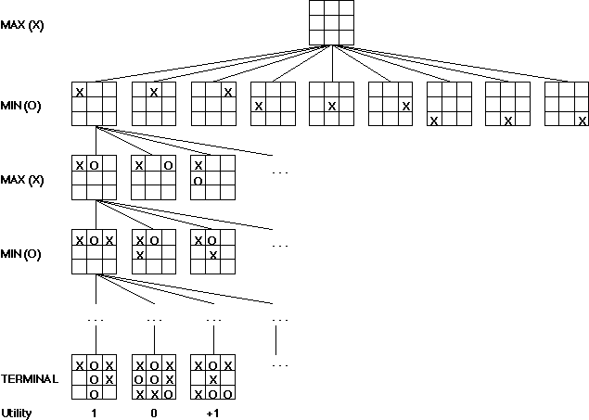
A Partial Game Tree for Tic-Tac-Toe
f(n)=8-8=0
f(n)=8-5=3
f(n)=2
f(n)=3
f(n)=2
f(n)=4
f(n)=2
f(n)=3
f(n)=2
f(n)=3
f(n)=6-5=1
f(n)=0
f(n)=1
f(n)=6-3=3
f(n)=6-2=4
f(n)=6-4=2
f(n)=# of potential three-lines for X –
# of potential three-line for O
f(n)=0 if n is a terminal tie
f(n)=+ ∞ if n is a terminal win
f(n)=- ∞ if n is a terminal loss
-∞
0
+ ∞
Notes:
note that solution requires a move that seems to lose ground: computer doesn’t mind, but people sometimes balk:
331-310/220/320-321-300-311-110*-221-020-031-010-021-000
note that 320 is a useless state because can only go from there back to parent
costs: if equal for all routes then no difference between310 and 220 as second state, but if costs for moving M is 3 and costs for moving C is 1 then is a difference: draw out this part of path clearly and illustrate
331-(2)-310-(1)-321 so cost is 3
331-(4)-220-(3)-321 s0 cost is 7

Slide 24
Chess Evaluation Functions
Claude Shannon argued for a chess evaluation function in a 1950 paper
Alan Turing defined function in 1948: f(n)=(sum of A’s piece values) -(sum of B’s piece values)
More complex: weighted sum of positional features:
Deep Blue had >8000 features
Pawn | 1.0
Knight | 3.0
Bishop | 3.25
Rook | 5.0
Queen | 9.0
Pieces values for a simple Turing-style evaluation function often taught to novice chess players
Positive: rooks on open files, knights in
closed positions, control of the center,
developed pieces
Negative: doubled pawns, wrong-colored
bishops in closed positions, isolated pawns,pinned pieces
Examples of more complex features

Slide 25
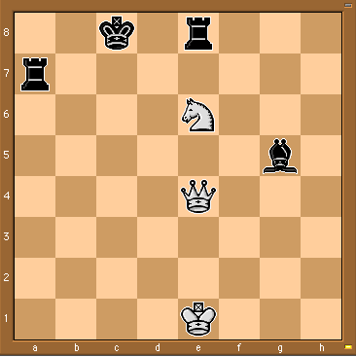
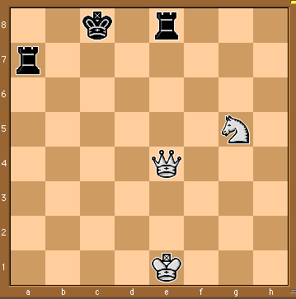
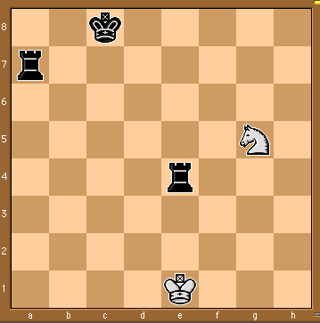
Some Chess Positions and their Evaluations
White to move
f(n)=(9+3)-(5+5+3.25)
=-1.25
… Nxg5??
f(n)=(9+3)-(5+5)
=2
Uh-oh: Rxg4+
f(n)=(3)-(5+5)
=-7
And black may
force checkmate
So, considering our opponent’s possible
responses would be wise.
Notes:
state space defined by initial state and operators, in book, states are implemented as nodes and actions as arcs.
a path represents a sequence of actions that (should) transform the intial world state into a world state that satisfies the goal. **trace on 8’s or VW**
solution: **trace on 8’s or VW**
the right representation can dramatically decrease the size of the state space, as we’ll see with the M&C problem.

Slide 26
The Minimax Rule (AIMA 5.2)

Slide 27
The Minimax Rule: “Don’t play hope chess”
Idea: Make the best move for MAX assuming that MIN always replies with the best move for MIN
Easily computed by a recursive process
The backed-up value of each node in the tree is determined by the values of its children:
For a MAX node, the backed-up value is the maximum of the values of its children (i.e. the best for MAX)
For a MIN node, the backed-up value is the minimum of the values of its children (i.e. the best for MIN)

Slide 28
The Minimax Procedure
Until game is over:
Start with the current position as a MAX node.
Expand the game tree a fixed number of ply.
Apply the evaluation function to the leaf positions.
Calculate back-up values bottom-up.
Pick the move assigned to MAX at the root
Wait for MIN to respond

Slide 29
MAX
2-ply Example: Backing up values
MIN
2
2
1
2
1
2
7
1
8
2
7
1
8
2
7
1
8
Evaluation function value
2
This is the move
selected by minimax
2
1
2
7
1
8

Slide 30
Adversarial Search (Minimax)
Minimax search:
A state-space search tree
Players alternate turns
Compute each node’s minimax value: the best achievable utility against a rational (optimal) adversary
Minimax values: computed recursively
5
max
2
5
min
8
2
5
6
Terminal values: part of the game
Notes:
Slide from Dan Klien

Slide 31
Minimax Implementation
def max-value(state):
initialize v = -∞
for each successor of state:
v = max(v, min-value(successor))
return v
def min-value(state):
initialize v = +∞
for each successor of state:
v = min(v, max-value(successor))
return v
Notes:
Slide from Dan Klien

Slide 32
Minimax Implementation
def max-value(state):
if the state is a terminal state: return the state’s utility
initialize v = -∞
for each successor of state:
v = max(v, min-value(successor))
return v
def min-value(state):
if the state is a terminal state: return the state’s utility
initialize v = +∞
for each successor of state:
v = min(v, max-value(successor))
return v
Notes:
Slide from Dan Klien

Slide 33
Minimax Implementation (Dispatch)
def value(state):
if the state is a terminal state: return the state’s utility
if the next agent is MAX: return max-value(state)
if the next agent is MIN: return min-value(state)
def max-value(state):
initialize v = -∞
for each successor of state:
v = max(v, value(successor))
return v
def min-value(state):
initialize v = +∞
for each successor of state:
v = min(v, value(successor))
return v
Notes:
Slide from Dan Klien
This allows you to also add in multiple MIN opponents. For instance, multiple ghosts in PacMan.

Slide 34
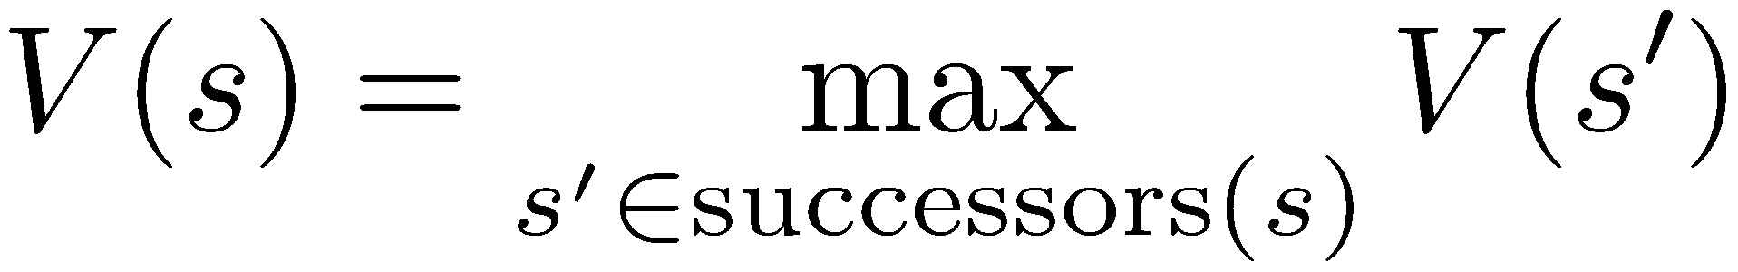
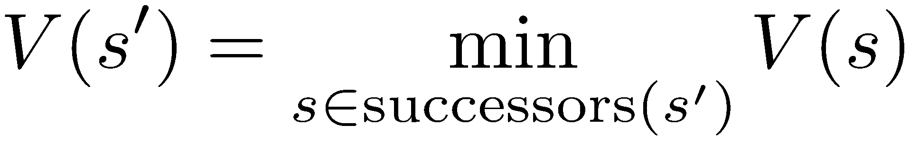
Minimax Example
3
12
8
2
4
6
14
5
2
def max-value(state):
initialize v = -∞
for each successor of state:
v = max(v, min-value(successor))
return v
def min-value(state):
initialize v = +∞
for each successor of state:
v = min(v, max-value(successor))
return v

Slide 35
Minimax Example
3
12
8
2
4
6
14
5
2
def max-value(state):
if the state is a terminal state: return the state’s utility
initialize v = -∞
for each successor of state:
v = max(v, min-value(successor))
return v
def min-value(state):
if the state is a terminal state: return the state’s utility
initialize v = +∞
for each successor of state:
v = min(v, max-value(successor))
return v

Slide 36
What if MIN does not play optimally?
Definition of optimal play for MAX assumes MIN plays optimally:
Maximizes worst-case outcome for MAX.
(Classic game theoretic strategy)
But if MIN does not play optimally, MAX will do even better.
This theorem is not hard to prove

Slide 37
Comments on Minimax Search
Depth-first search with fixed number of ply m as the limit.
O(b^{m}) time complexity – As usual!
O(bm) space complexity
Performance will depend on
the quality of the static evaluation function (expert knowledge)
depth of search (computing power and search algorithm)
Differences from normal state space search
Looking to make one move only, despite deeper search
No cost on arcs – costs from backed-up static evaluation
MAX can’t be sure how MIN will respond to his moves
Minimax forms the basis for other game tree search algorithms.

Slide 38
Alpha-Beta Pruning (AIMA 5.3)
Notes:
Many slides adapted from Richard Lathrop, USC/ISI, CS 271

Slide 39
Alpha-Beta Pruning
A way to improve the performance of the Minimax Procedure
Basic idea: “If you have an idea which is surely bad, don’t take the time to see how truly awful it is” ~ Pat Winston
>=2
We don’t need to compute the value at this node.
No matter what this is, it won’t change the value of the root node.
=2
<=1
2
7
1
?

Slide 40
Alpha-Beta Pruning
During Minimax, keep track of two additional values:
α: MAX’s current lower bound on MAX’s outcome
β: MIN’s current upper bound on MIN’s outcome
MAX will never allow a move that could lead to a worse score (for MAX) than α
MIN will never allow a move that could lead to a better score (for MAX) than β
Therefore, stop evaluating a branch whenever:
When evaluating a MAX node: a value v ≥ β is backed-up
MIN will never select that MAX node
When evaluating a MIN node: a value v ≤ α is found
MAX will never select that MIN node

Slide 41
Alpha-Beta Implementation
α: MAX’s best option on path to root
β: MIN’s best option on path to root
def max-value(state, α, β):
initialize v = -∞
for each successor of state:
v = max(v, value(successor, α, β))
if v ≥ β return v
α = max(α, v)
return v
def min-value(state , α, β):
initialize v = +∞
for each successor of state:
v = min(v, value(successor, α, β))
if v ≤ α return v
β = min(β, v)
return v
Notes:
Slide from Dan Klien
Pick an order for two reasons: sequential processor and pruning

Slide 42
Alpha-Beta Pruning Properties
This pruning has no effect on minimax value computed for the root!
Values of intermediate nodes might be wrong
Important: children of the root may have the wrong value
So the most naïve version won’t let you do action selection
Good child ordering improves effectiveness of pruning
With “perfect ordering”:
Time complexity drops to O(b^{m/2})
Doubles solvable depth!
Full search of, e.g. chess, is still hopeless…
This is a simple example of metareasoning (computing about what to compute)
max
min
10
10
0

Slide 43
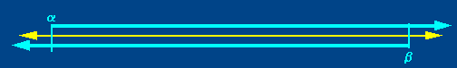

Alpha-Beta Pruning
Based on observation that for all viable paths utility value f(n) will be α <= f(n) <= β
Initially, α = -infinity, β=infinity
As the search tree is traversed, the possible utility value window shrinks as α increases, β decreases

Slide 44

Alpha-Beta Pruning
Whenever the current ranges of alpha and beta no longer overlap, it is clear that the current node is a dead end

Slide 45
Games and Adversarial Search II

Slide 46
Alpha-Beta Pruning (AIMA 5.3)
Some slides adapted from Richard Lathrop, USC/ISI, CS 271

Slide 47
Review: The Minimax Rule
Idea: Make the best move for MAX assuming that MIN always replies with the best move for MIN
Start with the current position as a MAX node.
Expand the game tree a fixed number of ply.
Apply the evaluation function to all leaf positions.
Calculate back-up values bottom-up:
For a MAX node, return the maximum of the values of its children (i.e. the best for MAX)
For a MIN node, return the minimum of the values of its children (i.e. the best for MIN
Pick the move assigned to MAX at the root
Wait for MIN to respond and REPEAT FROM 1

Slide 48
MAX
2-ply Example: Backing up values
MIN
2
2
1
2
1
2
7
1
8
2
7
1
8
2
7
1
8
Evaluation function value
2
This is the move
selected by minimax
2
1
New point: Actually calculated by DFS!
2
7
1
8

Slide 49
Minimax Algorithm
function MINIMAX-DECISION(state) returns an action
inputs: state, current state in game
v←MAX-VALUE(state)
return an action in SUCCESSORS(state) with value v
function MAX-VALUE(state) returns a utility value
if TERMINAL-TEST(state) then return UTILITY(state)
v ← -∞
for a,s in SUCCESSORS(state) do
v ← MAX(v, MIN-VALUE(s) )
return v
function MIN-VALUE(state) returns a utility value
if TERMINAL-TEST(state) then return UTILITY(state)
v ← ∞
for a,s in SUCCESSORS(state) do
v ← MIN(v, MAX-VALUE(s) )
return v

Slide 50
Alpha-Beta Pruning
A way to improve the performance of the Minimax Procedure
Basic idea: “If you have an idea which is surely bad, don’t take the time to see how truly awful it is” ~ Pat Winston
Assuming left-to-right tree traversal:
We don’t need to compute the value at this node!
No matter what it is it can’t effect the value of the root node.
>=2
=2
<=1
2
7
1
?

Slide 51
Alpha-Beta Pruning II
During Minimax, keep track of two additional values:
α: current lower bound on MAX’s outcome
β: current upper bound on MIN’s outcome
MAX will never choose a move that could lead to a worse score (for MAX) than α
MIN will never choose a move that could lead to a better score (for MAX) than β
Therefore, stop evaluating a branch whenever:
When evaluating a MAX node: a value v ≥ β is backed-up
MIN will never select that MAX node
When evaluating a MIN node: a value v ≤ α is found
MAX will never select that MIN node

Slide 52
Alpha-Beta Pruning IIIa
Based on observation that for all viable paths utility value f(n) will be α <= f(n) <= β
Initially, α = -infinity, β=infinity
As the search tree is traversed, the possible utility value window shrinks as α increases, β decreases

Slide 53
Alpha-Beta Pruning IIIb
Whenever the current ranges of alpha and beta no longer overlap (α ≥ β), it is clear that the current node is a dead end, so it can be pruned


Slide 54
Alpha-beta Algorithm: In detail
Depth first search (usually bounded, with static evaluation)
only considers nodes along a single path from root at any time
α = current lower bound on MAX’s outcome (initially, α = −infinity)
β = current upper bound on MIN’s outcome
(initially, β = +infinity)
Pass current values of α and β down to child nodes during search.
Update values of α and β during search:
MAX updates α at MAX nodes
MIN updates β at MIN nodes
Prune remaining branches at a node whenever α ≥ β
β
↓
↑
α

Slide 55
When to Prune
Prune whenever α ≥ β.
Prune below a Max node when its α value becomes ≥ the β value of its ancestors.
Max nodes update α based on children’s returned values.
Idea: Player MIN at node above won’t pick that value anyway, since MIN can force a worse value.
Prune below a Min node when its β value becomes ≤ the α value of its ancestors.
Min nodes update β based on children’s returned values.
Idea: Player MAX at node above won’t pick that value anyway; she can do better.
β
↓
↑
α

Slide 56
Pseudocode for Alpha-Beta Algorithm
function ALPHA-BETA-SEARCH(state) returns an action
inputs: state, current state in game
v←MAX-VALUE(state, - ∞ , +∞)
return an action in ACTIONS(state) with value v

Slide 57
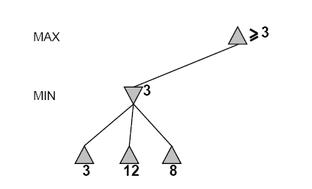
An Alpha-Beta Example
Do DF-search until first leaf
α, β, initial values
β
↓
↑
α
α=−∞
β =+∞
α, β, passed to kids
α=−∞
β =+∞

Slide 58
Alpha-Beta Example (continued)
β
↓
↑
α
α=−∞
β =+∞
α=−∞
β =3
MIN updates β, based on kids

Slide 59
Alpha-Beta Example (continued)
β
↓
↑
α
α=−∞
β =+∞
α=−∞
β =3
MIN updates β, based on kids.
No change.

Slide 60
Alpha-Beta Example (continued)
β
↓
↑
α
MAX updates α, based on kids.
α=3
β =+∞
3 is returned
as node value.

Slide 61
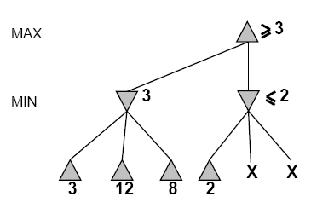
Alpha-Beta Example (continued)
α=3
β =+∞
β
↓
↑
α
α, β, passed to kids
α=3
β =+∞

Slide 62
Alpha-Beta Example (continued)
α=3
β =+∞
β
↓
↑
α
MIN updates β,
based on kids.
α=3
β =2

Slide 63
Alpha-Beta Example (continued)
α=3
β =+∞
β
↓
↑
α
α=3
β =2
α ≥ β,
so prune.

Slide 64
Alpha-Beta Example (continued)
MAX updates α, based on kids.
No change.
α=3
β =+∞
β
↓
↑
α
2 is returned
as node value.

Slide 65
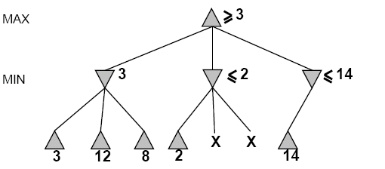
Alpha-Beta Example (continued)
β
↓
↑
α
α=3
β =+∞
,
α, β, passed to kids
α=3
β =+∞

Slide 66
Alpha-Beta Example (continued)
β
↓
↑
α
α=3
β =+∞
,
MIN updates β,
based on kids.
α=3
β =14

Slide 67
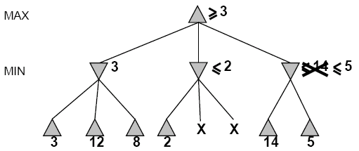
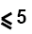
Alpha-Beta Example (continued)
β
↓
↑
α
α=3
β =+∞
,
MIN updates β,
based on kids.
α=3
β =5

Slide 68
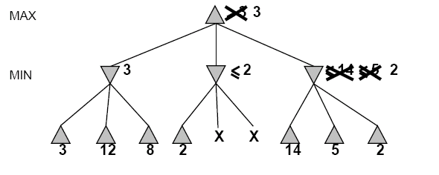
Alpha-Beta Example (continued)
β
↓
↑
α
α=3
β =+∞
2 is returned
as node value.
2

Slide 69
Alpha-Beta Example (continued)
Max now makes it’s best move, as computed by Alpha-Beta
β
↓
↑
α
2

Slide 70
Alpha-Beta Algorithm Pseudocode
function ALPHA-BETA-SEARCH(state) returns an action
inputs: state, current state in game
v←MAX-VALUE(state, - ∞ , +∞)
return an action in ACTIONS(state) with value v
function MAX-VALUE(state,α , β) returns a utility value
if TERMINAL-TEST(state) then return UTILITY(state)
v ← - ∞
for a in ACTIONS(state) do
v ← MAX(v,MIN-VALUE(Result(s,a), α , β))
if v ≥ β then return v
α ← MAX(α ,v)
return v

Slide 71
Alpha-Beta Algorithm II
function MIN-VALUE(state, α , β) returns a utility value
if TERMINAL-TEST(state) then return UTILITY(state)
v ← + ∞
for a,s in SUCCESSORS(state) do
v ← MIN(v,MAX-VALUE(s, α , β))
if v ≤ α then return v
β ← MIN(β ,v)
return v

Slide 72
Effectiveness of Alpha-Beta Pruning
Guaranteed to compute same root value as Minimax
Worst case: no pruning, same as Minimax (O(b^{d}))
Best case: when each player’s best move is the first option examined, examines only O(b^{d/2}) nodes, allowing to search twice as deep!
Notes:
Best case:
* children of Max nodes are searched in greatest-value-first order,
children of Min nodes are searched in least-value-first order
* Alpha-Beta’s time complexity is O(b^d/2) ⇒ doubles the solvable depth
In the worst case, where there is no node to be pruned, the full tree will be examined (or the complete tree up to the cutoff at a depth d). Alpha beta pruning saves, but how much? Notice that in the best case, each node will examine 2b-1 grandchildren to decide on its value. In the worst case, the node would examine b^2 grandchildren. This essentially means that the overall algorithm examined O( b^(d/2) ) nodes, the same as a worst-case algorithm whose cutoff is half of d. In practice this is significant.

Slide 73
When best move is the first examined, examines only O(b^{d/2}) nodes….
So: run Iterative Deepening search, sort by value returned on last iteration.
So: expand captures first, then threats, then forward moves, etc.
O(b^{(d/2)}) is the same as having a branching factor of sqrt(b),
Since (sqrt(b))^{d} = b^{(d/2)}
e.g., in chess go from b ~ 35 to b ~ 6
For Deep Blue, alpha-beta pruning reduced the average branching factor from 35-40 to 6, as expected, doubling search depth

Slide 74
Real systems use a few more tricks
Expand the proposed solution a little farther
Just to make sure there are no surprises
Learn better board evaluation functions
E.g., for backgammon
Learn model of your opponent
E.g., for poker
Do stochastic search
E.g., for go

Slide 75

Expectimax
Read AIMA Chapter 16.1-16.3,
Slides courtesy of Dan Klein and Pieter Abbeel University of California, Berkeley

Slide 76
Uncertain Outcomes

Slide 77
Worst-Case vs. Average Case
max
min
10
10
9
100
Idea: Uncertain outcomes controlled by chance, not an adversary!
Notes:
At least 10, or otherwise just rather dead; or just 100, or otherwise rather dead; that’s yet something different than minimax or expectimax
Down arrows = min nodes
Circles = chance nodes.

Slide 78
Expectimax Search
Why wouldn’t we know what the result of an action will be?
Explicit randomness: rolling dice
Unpredictable opponents: the opponent isn’t optimal
Actions can fail: when moving a robot, wheels might slip
Values should now reflect average-case (expectimax) outcomes, not worst-case (minimax) outcomes
Expectimax search: compute the average score under optimal play
Max nodes as in minimax search
Chance nodes are like min nodes but the outcome is uncertain
Calculate their expected utilities
I.e. take weighted average (expectation) of children
Later, we’ll learn how to formalize the underlying uncertain-result problems as Markov Decision Processes
max
chance
10
10
4
10
5
9
7
100

Slide 79
Expectimax Pseudocode
def value(state):
if the state is a terminal state: return the state’s utility
if the next agent is MAX: return max-value(state)
if the next agent is EXP: return exp-value(state)
def max-value(state):
initialize v = -∞
for each successor of state:
v = max(v, value(successor))
return v
def exp-value(state):
initialize v = 0
for each successor of state:
p = probability(successor)
v += p * value(successor)
return v
Notes:
Max is just like before. Exp is the expectation of what will happen next.

Slide 80
Expectimax Pseudocode
def exp-value(state):
initialize v = 0
for each successor of state:
p = probability(successor)
v += p * value(successor)
return v
1/2
1/6
1/3
5
8
7
24
-12
v = (1/2) (8) + (1/3) (24) + (1/6) (-12) = 10

Slide 81
Expectimax Example
3
12
9
2
4
6
15
6
0
Notes:
Here imagine that all children are equally likely.
8 … 4 …. 7

Slide 82
Expectimax Pruning?
3
12
9
2
Notes:
In Minimax we were done, since 2 would always be less than 3.
Here the average of 3, 12 and 9 = 8.
Can the average be less than 2 on the middle node? YES!!! Much harder to prune.

Slide 83
Depth-Limited Expectimax
Estimate of true expectimax value (which would require a lot of work to compute)
400
300
…
…
492
362
…
Notes:
Let’s image they are actually random ghosts. 2 layers of random ghost actions.
At the actual end of the game, we have the score. But we can’t do that so we have to cut the process off.
So we need some way of evaluating the

Slide 84
Probabilities

Slide 85
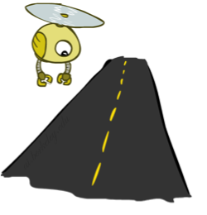
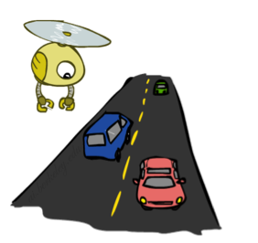
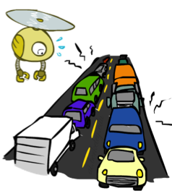
Probabilities
A random variable represents an event whose outcome is unknown
A probability distribution is an assignment of weights to outcomes
Example: Traffic on freeway
Random variable: T = whether there’s traffic
Outcomes: T in {none, light, heavy}
Distribution: P(T=none) = 0.25, P(T=light) = 0.50, P(T=heavy) = 0.25
Some laws of probability (more later):
Probabilities are always non-negative
Probabilities over all possible outcomes sum to one
As we get more evidence, probabilities may change:
P(T=heavy) = 0.25, P(T=heavy | Hour=8am) = 0.60
We’ll talk about methods for reasoning and updating probabilities later
0.25
0.50
0.25
Notes:
In general, we will be computing probabilities. As we get more evidence the probabilities will change. We will look at Probabilistic Inference later in this course.

Slide 86
Expectations
The expected value of a function of a random variable is the average, weighted by the probability distribution over outcomes
Example: How long to get to the airport?
Time:
20 min
30 min
60 min
x
+
x
+
x
35 min
Probability:
0.25
0.50
0.25

Slide 87
What Probabilities to Use?
In expectimax search, we have a probabilistic model of how the opponent (or environment) will behave in any state
Model could be a simple uniform distribution (roll a die)
Model could be sophisticated and require a great deal of computation
We have a chance node for any outcome out of our control: opponent or environment
The model might say that adversarial actions are likely!
For now, assume each chance node magically comes along with probabilities that specify the distribution over its outcomes
Having a probabilistic belief about another agent’s action does not mean that the agent is flipping any coins!
Notes:
Where do the probabilities come from? For today, they come from the probability fairy. They are given by the problem definition. Later we will look at how to compute them.

Slide 88
What are Probabilities?
Objectivist / frequentist answer:
Averages over repeated experiments
E.g. empirically estimating P(rain) from historical observation
Assertion about how future experiments will go (in the limit)
New evidence changes the reference class
Makes one think of inherently random events, like rolling dice
Subjectivist / Bayesian answer:
Degrees of belief about unobserved variables
E.g. an agent’s belief that it’s raining, given the temperature
E.g. agent’s belief how an opponent will behave, given the state
Often learn probabilities from past experiences (more later)
New evidence updates beliefs (more later)

Slide 89
Quiz: Informed Probabilities
Let’s say you know that your opponent is actually running a depth 2 minimax, using the result 80% of the time, and moving randomly otherwise
Question: What tree search should you use?
Answer: Expectimax!
To figure out EACH chance node’s probabilities, you have to run a simulation of your opponent
This kind of thing gets very slow very quickly
Even worse if you have to simulate your opponent simulating you…
… except for minimax, which has the nice property that it all collapses into one game tree
0.1 0.9
Notes:
…Except, what if your opponent simulates you? You can get into this crazy recursive trees. If you go too far down the computation then
That only really works out for minimax.

Slide 90
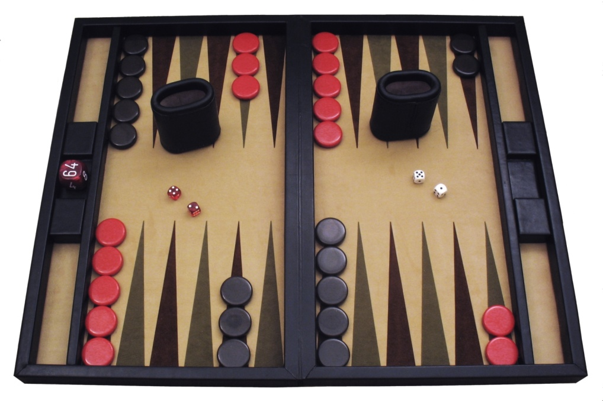
Example: Backgammon
Dice rolls increase b: 21 possible rolls with 2 dice
Backgammon ≈ 20 legal moves
Depth 2 = 20 x (21 x 20)³ = 1.2 x 10⁹
As depth increases, probability of reaching a given search node shrinks
So usefulness of search is diminished
So limiting depth is less damaging
But pruning is trickier…
Historic AI: TDGammon uses depth-2 search + very good evaluation function + reinforcement learning: world-champion level play
1st AI world champion in any game!
Image: Wikipedia

Slide 91
Mixed Layer Types
E.g. Backgammon
Expectiminimax
Environment is an extra “random agent” player that moves after each min/max agent
Each node computes the appropriate combination of its children
Max nodes
Chance nodes
Min nodes
Notes:
I move, you move. Each tie, we roll some dice. This is an expectimenimax tree.
If it’s terminal or we reached our depth limit, return utility.

Slide 92
Utilities
AIMA Chapter 16.1-16.3
Notes:
Everything in minimax and expectimax has referenced the notion of Utilties. The idea that there are values that you can go around either maximizing or minimizing or taking the average of.
What are these numbers? Where do they come from? How do we even know that they exist?

Slide 93
Maximum Expected Utility
Why should we average utilities? Why not minimax?
Principle of maximum expected utility:
A rational agent should chose the action that maximizes its expected utility, given its knowledge
Questions:
Where do utilities come from?
How do we know such utilities even exist?
How do we know that averaging even makes sense?
What if our behavior (preferences) can’t be described by utilities?
Notes:
If we have utilities, why should we ever average them?
The answer is vampire bunnies. Worst case reasoning only works if your model is able to assign very low probabilities to very bad events. You need probabilistic reasoning and averages.
This is going to lead us down the path of probabilistic reasoning.
Are humans so complex that they can’t be boiled down to these probabilities?

Slide 94
What Utilities to Use?
0
40
20
30
x²
0
1600
400
900
For worst-case minimax reasoning, terminal function scale doesn’t matter
We just want better states to have higher evaluations (get the ordering right)
We call this insensitivity to monotonic transformations
For average-case expectimax reasoning, we need magnitudes to be meaningful
Notes:
Minimax is really about the ordering of the states.
IN expectiax, the right tree would give me average of 20 and 25, so I would take the right branch. What about in the right tree? That would give me 800 and 650, so I would take the left branch.
The magnitudes are very important here.

Slide 95

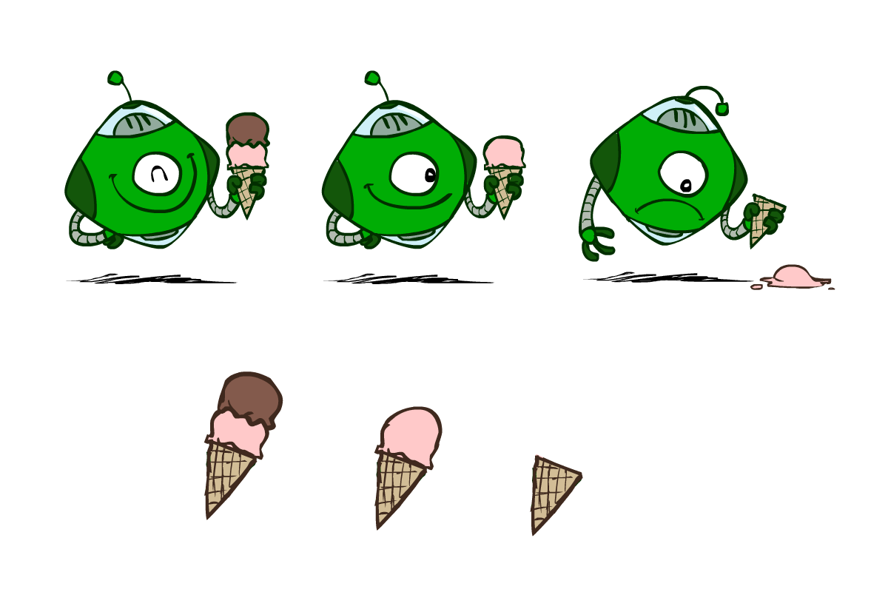
Utilities
Utilities are functions from outcomes (states of the world) to real numbers that describe an agent’s preferences
Where do utilities come from?
In a game, may be simple (+1/-1)
Utilities summarize the agent’s goals
Theorem: any “rational” preferences can be summarized as a utility function
We hard-wire utilities and let behaviors emerge
Why don’t we let agents pick utilities?
Why don’t we prescribe behaviors?

Slide 96
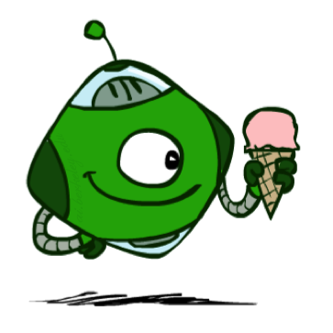
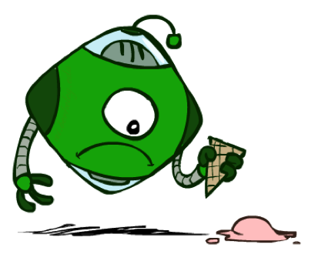
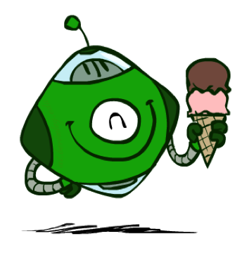
Utilities: Uncertain Outcomes
Getting ice cream
Get Single
Get Double
Oops
Whew!
Notes:
The robot has to choose not only between utilities, but also uncertain outcomes.

Slide 97
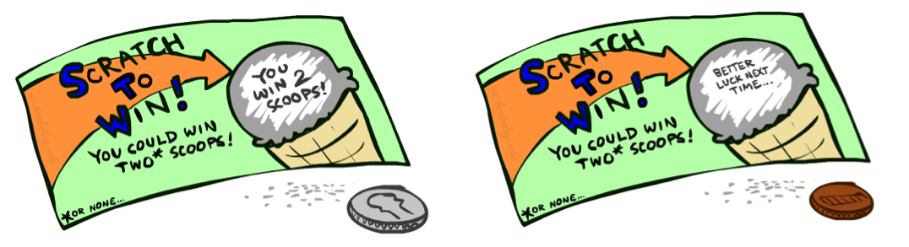
Preferences
An agent must have preferences among:
Prizes: A, B, etc.
Lotteries: situations with uncertain prizes
Notation:
Preference:
Indifference:
A Prize
A Lottery
A
p 1-p
A B
Notes:
A prize is a given outcome.
Lotteries are mixtures with probabilities attached.

Slide 98
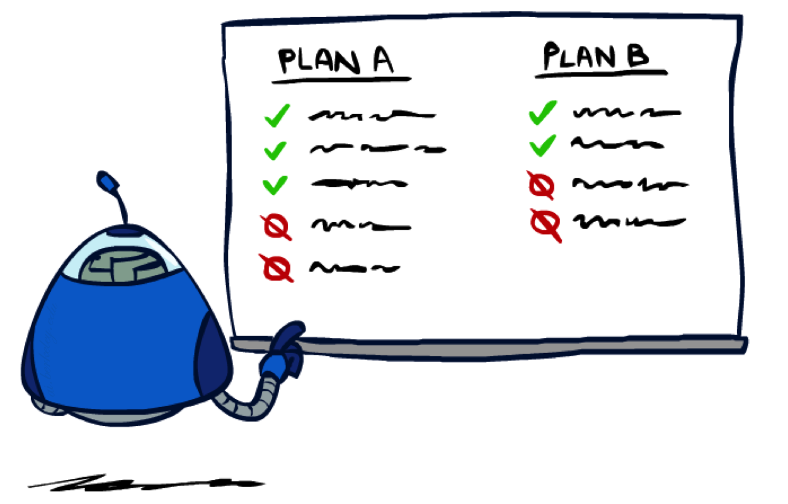
Rationality
Notes:
Are there good preferences and bad preferences? What do we need in order to decide is an agent is rational?

Slide 99
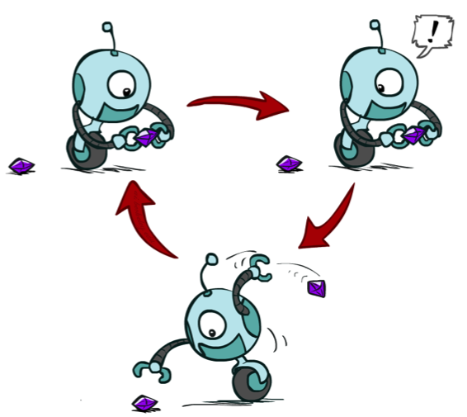
Rational Preferences
We want some constraints on preferences before we call them rational, such as:
For example: an agent with intransitive preferences can
be induced to give away all of its money
If B > C, then an agent with C would pay (say) 1 cent to get B
If A > B, then an agent with B would pay (say) 1 cent to get A
If C > A, then an agent with A would pay (say) 1 cent to get C
Axiom of Transitivity:
Notes:
Apple, banana, carrot
Some things don’t make sense.
... This is a defect in behavior.

Slide 100

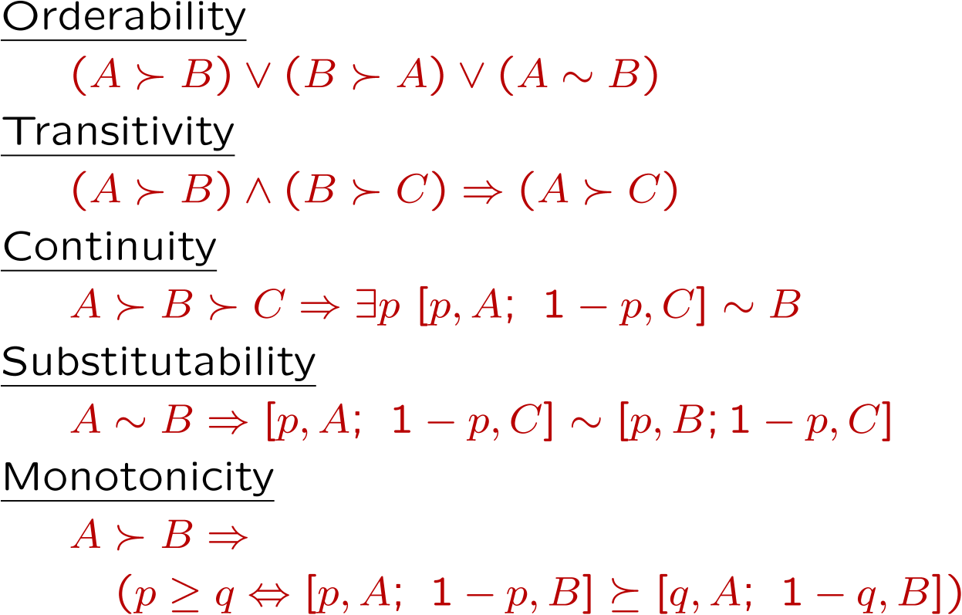
Rational Preferences
The Axioms of Rationality
Theorem: Rational preferences imply behavior describable as maximization of expected utility
Notes:
Orderability. You have to like A better or B better or be indifferent.
Transitivity, we just saw.
Continuity. More subtle. If you like A better than C and B is somewhere in the middle. Then there has to be some lottery between A and C, where you’re indifferent with B.
Substitutability. If they’re exchangeable on their own then they are exchangeable in a lottery.
Monotonicity. Also reasonable. If A is better than B, and you have a lottery between A and B, then you would prefer more A in the mix.
If you accept these actions, then rational preferences that obey these, then all of your behavior is describable by maximizing utilities.

Slide 101
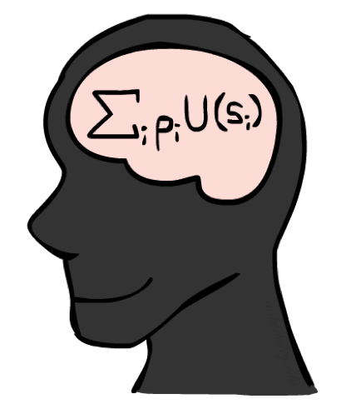
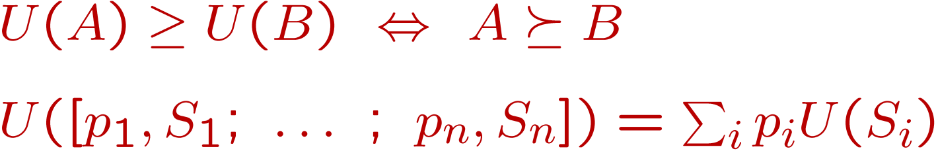
MEU Principle
Theorem [Ramsey, 1931; von Neumann & Morgenstern, 1944]
Given any preferences satisfying these constraints, there exists a real-valued
function U such that:
I.e. values assigned by U preserve preferences of both prizes and lotteries!
Maximum expected utility (MEU) principle:
Choose the action that maximizes expected utility
Note: an agent can be entirely rational (consistent with MEU) without ever representing or manipulating utilities and probabilities
E.g., a lookup table for perfect tic-tac-toe, a reflex vacuum cleaner
Notes:
Here’s the theorem.
There exists a real valued function U with the following properties.
U captures your ordinal preferences.
Utility of a lottery is the expectation of the elements of the lottery.
This means the utility captures your preference not only between prizes, but between lotteries!
It’s amazing! It means your utilities are preserved under expectation.
You want your BEHAVIORS to be consistent to the MEU Princple.

Slide 102
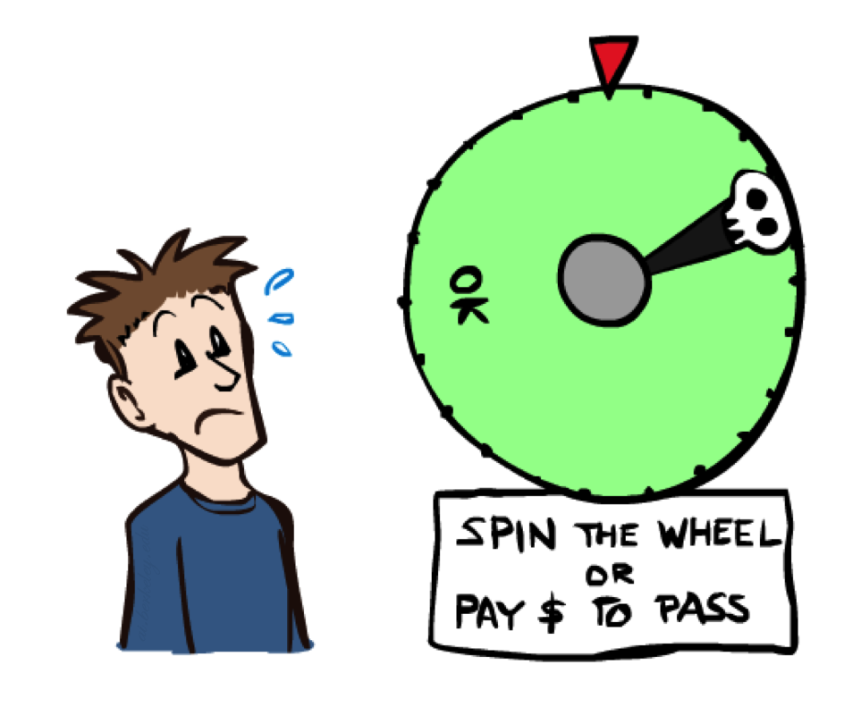
Human Utilities
Notes:
You can be represented with utilities! And MEU.

Slide 103

Utility Scales
Normalized utilities: u₊ = 1.0, u₋ = 0.0
Micromorts: one-millionth chance of death, useful for paying to reduce product risks, etc.
QALYs: quality-adjusted life years, useful for medical decisions involving substantial risk
Note: behavior is invariant under positive linear transformation
With deterministic prizes only (no lottery choices), only ordinal utility can be determined, i.e., total order on prizes
Notes:
These are kind of morbid. Reason about product recalls, where you’re talking about chance of death.
How do I actually get the real valued numbers that you assign to U?
I need to ask you questions about lotteries….

Slide 104


Human Utilities
Utilities map states to real numbers. Which numbers?
Standard approach to assessment (elicitation) of human utilities:
Compare a prize A to a standard lottery L_{p} between
“best possible prize” u₊ with probability p
“worst possible catastrophe” u₋ with probability 1-p
Adjust lottery probability p until indifference: A ~ L_{p}
Resulting p is a utility in [0,1]
Pay $30
0.999999 0.000001
No change
Instant death
Notes:
Elicit preferences.
Slide the value until the person becomes indifferent. That’s the way that I can assign a number to U.
How much do you NOT want to pay $30? No change is better than paying $30, instant death is worse.
Once I find that magical probability that makes you indifferent, then I know U.
If we made it worse, pay $3m be in debt forever.

Slide 105
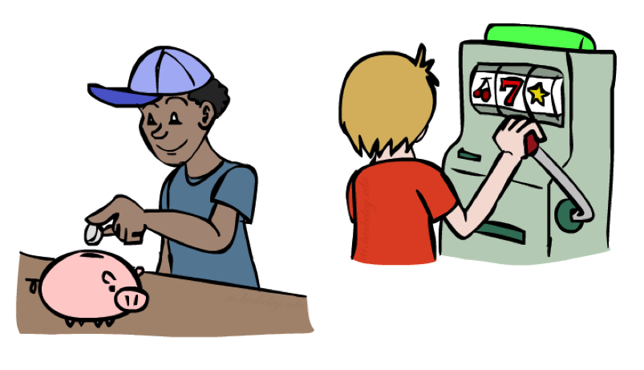
Money
Money does not behave as a utility function, but we can talk about the utility of having money (or being in debt)
Given a lottery L = [p, $X; (1-p), $Y]
The expected monetary value EMV(L) is p*X + (1-p)*Y
U(L) = p*U($X) + (1-p)*U($Y)
Typically, U(L) < U( EMV(L) )
In this sense, people are risk-averse
When deep in debt, people are risk-prone
Notes:
How about money? Can we use money as a utility scale? No! It’s not a good utility scale. We can talk about the utility of money, but it itself isn’t a good utility scale. Why not?
Imagine a lottery where you get X dollars or Y dollars.
Obviously, how good this is depends on X, Y and p.
Typically a utility of a lottery over money is worth less than its equivalent monetary value.
You’d rather have a smaller amount that is guaranteed.
How many of you would like a million dollars?
How many of you would like a billion dollars? How much more? 1000x more? Maybe not?
Let’s say I gave you a billion. Now how much do you want a million? Not much.
Diminishing returns. I’m told after your first billion, your second billion has less utility.
Same thing in the negative. Once you’re $1b in debt, whatever, you’re too big.

Slide 106
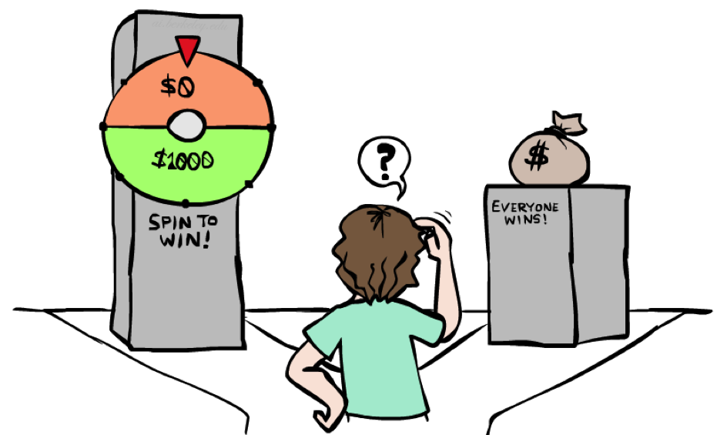
Example: Insurance
Consider the lottery [0.5, $1000; 0.5, $0]
What is its expected monetary value? ($500)
What is its certainty equivalent?
Monetary value acceptable in lieu of lottery
$400 for most people
Difference of $100 is the insurance premium
There’s an insurance industry because people will pay to reduce their risk
If everyone were risk-neutral, no insurance needed!
It’s win-win: you’d rather have the $400 and the insurance company would rather have the lottery (their utility curve is linear and they have many lotteries)
Notes:
Lottery example = $1000 computer, 50% chance that you’ll get it stolen, in which case you are left with $0.
Certainty equivalent. That’s how much money you would be willing to trade this lottery for. Trade uncertainty for certainty.
Certainty equivalent. How much would you trade this lottery for? How many would trade this for $10? How about $900? How about $400?
Because of these preferences there are things like insurance.
Is insurance just a scam? No, it’s win-win!

Slide 107

Example: Human Rationality?
Famous example of Allais (1953)
A: [0.8, $4k; 0.2, $0]
B: [1.0, $3k; 0.0, $0]
C: [0.2, $4k; 0.8, $0]
D: [0.25, $3k; 0.75, $0]
Most people prefer B > A, C > D
But if U($0) = 0, then
B > A ⇒ U($3k) > 0.8 U($4k)
C > D ⇒ 0.8 U($4k) > U($3k)
Notes:
Are humans perfectly rational? Here’s a classic experiment
B is the clear winner.
C is the winner.
Most people prefer C over D.
Multiply C and D by 4 and get the opposite conclusion 0.2*4 = 0.8, 0.25*4 = 1, so 0.8 U($4k) > 1.0 * U($3k)
So what the heck? You’re making irrational preferences? Are you irrational or did I do something wrong?
There’s a lot going on.
Prize B said 100% chance of 3k. 0 is actually important.
What do you get if you choose A, and you win $0? You get the feeling of stupidity.

